Slide 1

Note: The data and information in this document is reflective of a hypothetical situation and client. This document is to be used for KPMG Virtual Internship purposes only.
Sprocket Central Pty Ltd
Data analytics approach
Gokila Sundaram

Slide 2
Note: The data and information in this document is reflective of a hypothetical situation and client. This document is to be used for KPMG Virtual Internship purposes only.
Agenda
Introduction
Goals & Objective
Business Question
Data Exploration
Data Exploration Tasks & Timelines
Model Development
Predictive Modeling
Interpretation

Slide 3
Note: The data and information in this document is reflective of a hypothetical situation and client. This document is to be used for KPMG Virtual Internship purposes only.
Introduction
Approach to Target High-Value Customers (Market Penetration):
The 3 datasets available for analysis, shows the customer buying patterns during the year 2017.
We strongly recommend that Data Analytics helps in Customer Segmentation & to predict the potential customers by Job Title, Industry category, Age group & Tenure. A detailed approach to Target High-value customers will be discussed in this presentation.
Place any supporting images, graphs, data or extra text here.

Slide 4
Goals & Objective
Goals:
To determine customer trends and behaviour.
To recommend high-value customer from NewcustomerList Data.
Objective:
Existing Customer Segmentation based on Last Year Transanctions and Customer demography
Predict the high-value customers from NewcustomerList Dataset.

Slide 5
Business Questions…
Data analytics will provide an insight into the following questions:
What is the highest count of transactions made by individual customers?
Which gender had the highest number of transactions last year?
Which Age Groups among customers are suitable for targeting?
What job titles indicate the highest interest in bike sales among customers?
In which job industry category were the sales most prominent last year?
What wealth segment do the highly interested customers fall into?
Can customers with cars be considered as potential targets?
Should customer tenure period be taken into consideration?
Which state is a viable target for our efforts?
What is the population of potential customers by state?
Does property valuation significantly impact buying patterns?

Slide 6
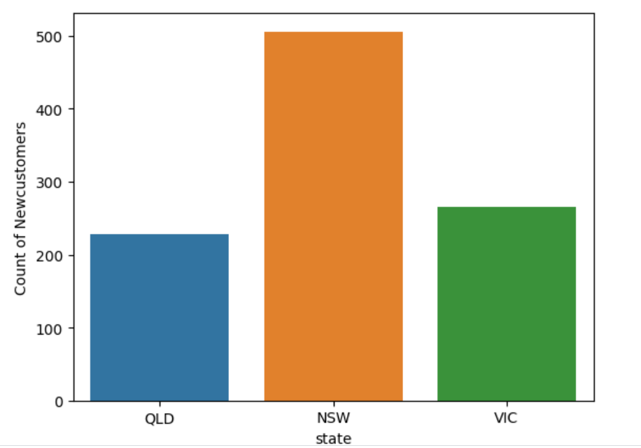
Note: The data and information in this document is reflective of a hypothetical situation and client. This document is to be used for KPMG Virtual Internship purposes only.
Data Exploration
Visualize the Patterns & Trends
Exploring or understanding the data is critical for obtaining precise insights. This phase involves in-depth analysis of data distributions, feature engineering, and data transformations.
The given datasets(Transactions, Customer Demographic, CustomerAddress) will be thoroughly explored to visualize patterns and trends. Additional attributes, including Age and Age group, will be incorporated to extract comprehensive insights.
Place any supporting images, graphs, data or extra text here.

Slide 7
Note: The data and information in this document is reflective of a hypothetical situation and client. This document is to be used for KPMG Virtual Internship purposes only.
Data Exploration Tasks & Milestones
Tasks | Deliverables | Timeline(hrs)
Understanding the Dataset | Cleaned\Preprocessed data without Missing values | 3
Data Transformations | Dataset with Consistent format | 2
Descriptive Statistics | Standardized Dataset | 2
Data Visualization | Correlation Heatmaps, Scatter Plots, Histograms | 3
Outlier Detection | Refined Dataset with accurate values | 2
Feature Engineering | List of relevant features for Predictive Modeling | 3
Summary and Insights | recommendations based on the exploration | 3

Slide 8
Note: The data and information in this document is reflective of a hypothetical situation and client. This document is to be used for KPMG Virtual Internship purposes only.
Model Development
Build the Machine Learning Model:
Following unsupervised models will be used for existing customer segmentation based on their purchase patterns.
K-means clustering:
Hierarchical Clustering
Approach:
Identify the relevant number of clusters using WCSS method (Within-Cluster Sum of Squares)
Identify the feature engineering metrics such as Recency, Frequency and Monetary of existing customers.
Segment customers based on RFM Metrics.
Create a New Label and categorize customers as High, Low, Medium value customers.
Estimated TimeLine: 40hrs

Slide 9
Note: The data and information in this document is reflective of a hypothetical situation and client. This document is to be used for KPMG Virtual Internship purposes only.
Predictive Modeling
Build a Predict Model:
Following models will be used for Predicting the high-Value customers from the NewcustomerList:
Logistic Regression
Random Forest Classifier
Multi-Layer Perceptron
Approach:
Train the models with segmented customer dataset from the previous step
Test the model with unseen data (New customer List)
Estimated TimeLine: 40hrs

Slide 10
Note: The data and information in this document is reflective of a hypothetical situation and client. This document is to be used for KPMG Virtual Internship purposes only.
Interpretation
Recommended Models for Prediction:
Evaluate the performance of Predictive models using following metrics:
Accuracy, Precision, Recall, F1-Score
Approach:
Based on the performance metrics, Predictive model will be recommended.
Newcustomerlist will be segmented as High, Low and Medium value customers by the Predictive Models.
Provide insights into the characteristics of target customers.
Estimated Timeline: 10hrs

Slide 11
Note: The data and information in this document is reflective of a hypothetical situation and client. This document is to be used for KPMG Virtual Internship purposes only.
Appendix

Slide 12
Note: The data and information in this document is reflective of a hypothetical situation and client. This document is to be used for KPMG Virtual Internship purposes only.
Appendix
This is an optional slide where you may place any supporting items.

